Slide 1
Internet Traffic Monitoring and Analysis: Wireshark Tutorial
Kevin Curran

Slide 2

What is Wireshark?
The Network Protocol Analyzer
Open-Source (GNU Public License)
Multi-platform (Windows, Linux, OS X, Solaris, FreeBSD, NetBSD, and others)
Easily extensible
Large development group
Previously Named “Ethereal”
Features
Deep inspection of thousands of protocols
Live capture and offline analysis
Standard three-pane packet browser
Captured network data can be browsed via a GUI, or via the TTY-mode TShark utility
The most powerful display filters in the industry
Rich VoIP analysis
Live data can be read from Ethernet, IEEE 802.11, PPP/HDLC, ATM, Bluetooth, USB, Token Ring, Frame Relay, FDDI, and others
Coloring rules can be applied to the packet list for quick, intuitive analysis
Output can be exported to XML, PostScript®, CSV, or plain text

Slide 3
What is Wireshark?
What we can do:
Capture network traffic
Decode packet protocols using dissectors
Define filters – capture and display
Watch smart statistics
Analyze problems
Interactively browse that traffic
Some examples people use Wireshark for:
Network administrators: troubleshoot network problems
Network security engineers: examine security problems
Developers: debug protocol implementations
People: learn network protocol internals

Slide 4
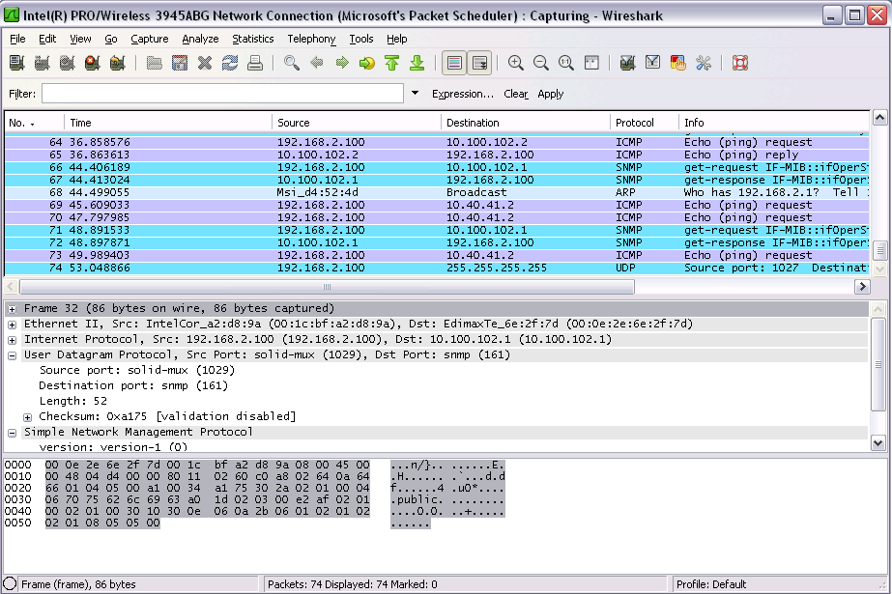
Interfaces
Packet
List
Packet
Details
Packet
Bytes

Slide 5
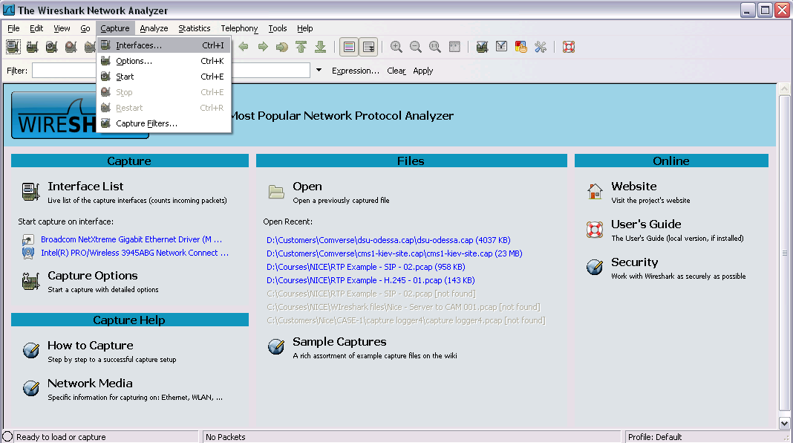
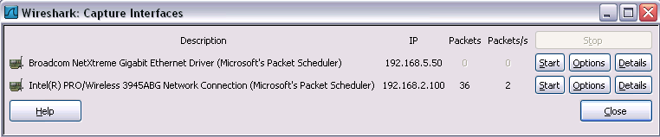
Capturing Packets (1/3)

Slide 6
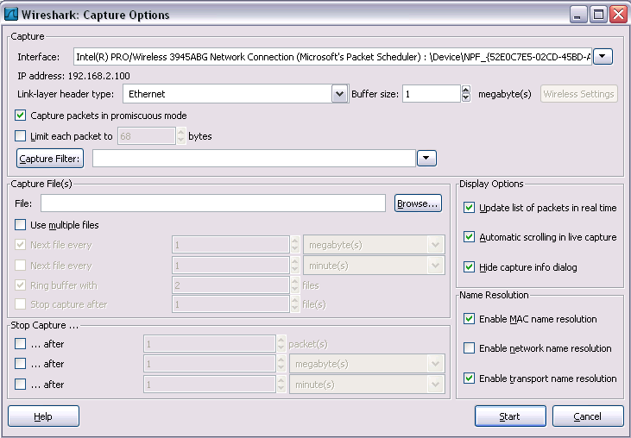
Capturing Packets (2/3)
Capture all packets on the network
Buffer size – in order not to fill your laptop disk
Capture filter
Display options
Capture in multiple files
Name resolution options
When to automatically stop the capture

Slide 7
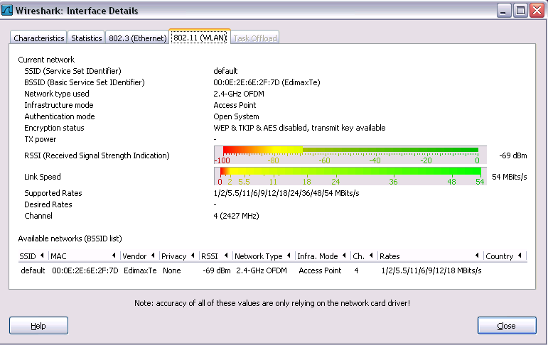
Capturing Packets (3/3)
Example (W-LAN):
Received Signal Strength Indication (RSSI) and Link speed (BW)

Slide 8
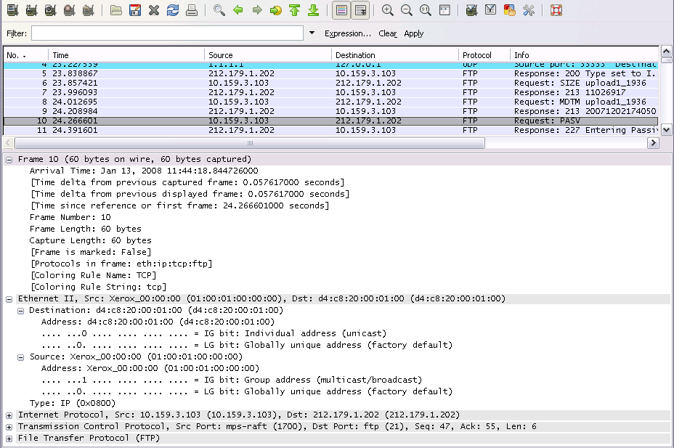
Analyzing Packets (1/9)
Ethernet Frame Example

Slide 9
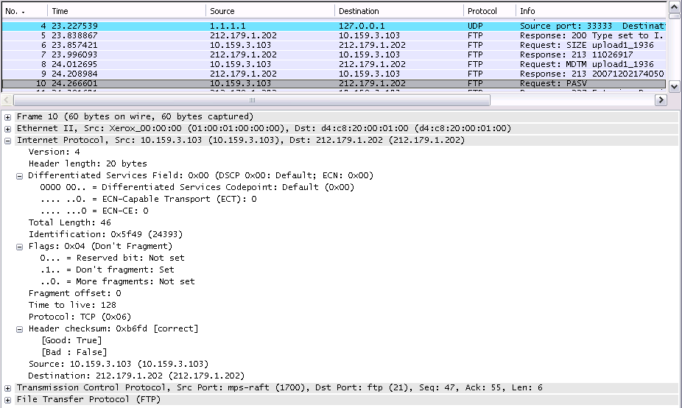
Analyzing Packets (2/9)
IP Packet Example

Slide 10
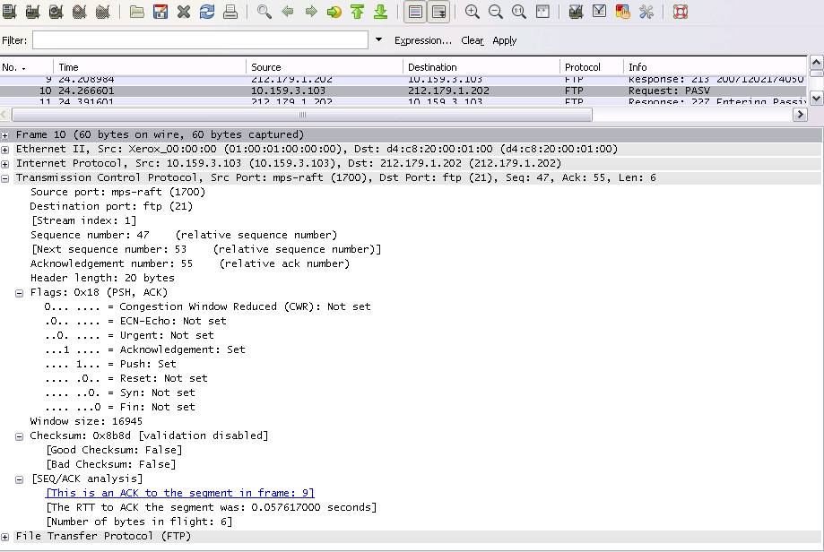
Analyzing Packets (3/9)
TCP Packet Example

Slide 11
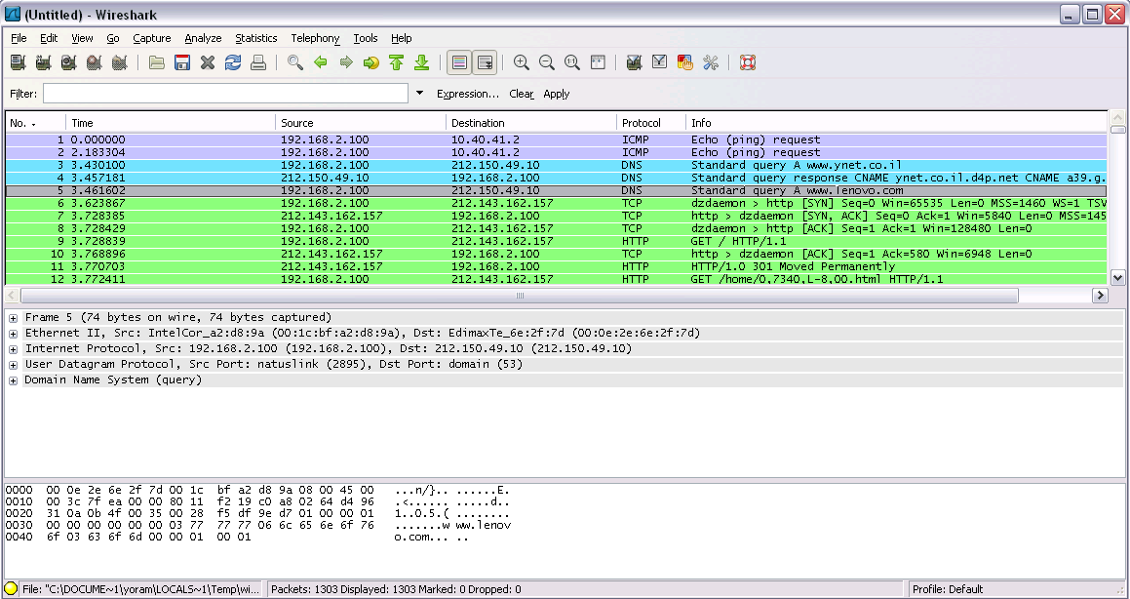
Analyzing Packets (4/9)
TCP 3-way Handshake
SYN
SYN, ACK
ACK

Slide 12
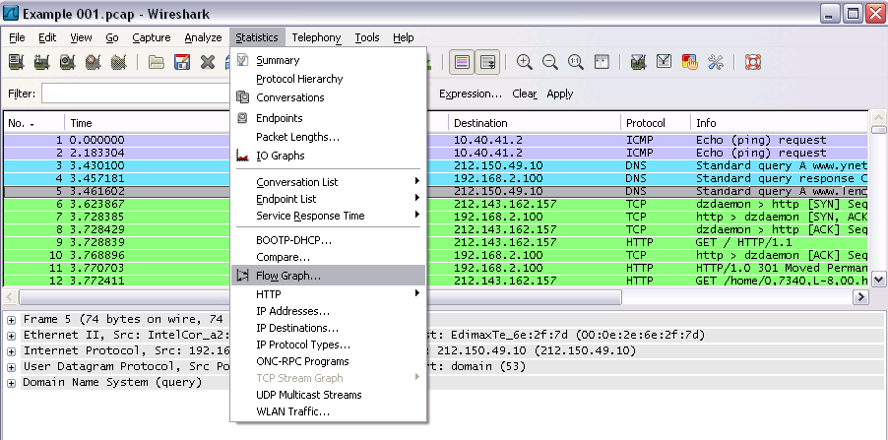
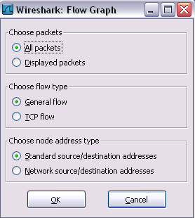
Analyzing Packets (5/9)
Flow Graph
Giving us a graphical flow, for better understanding of what we see

Slide 13
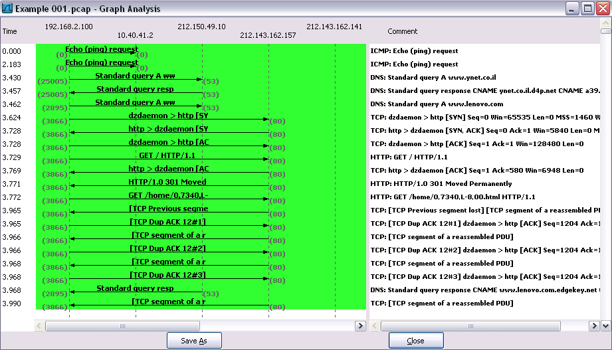
Analyzing Packets (6/9)
Flow Graph

Slide 14
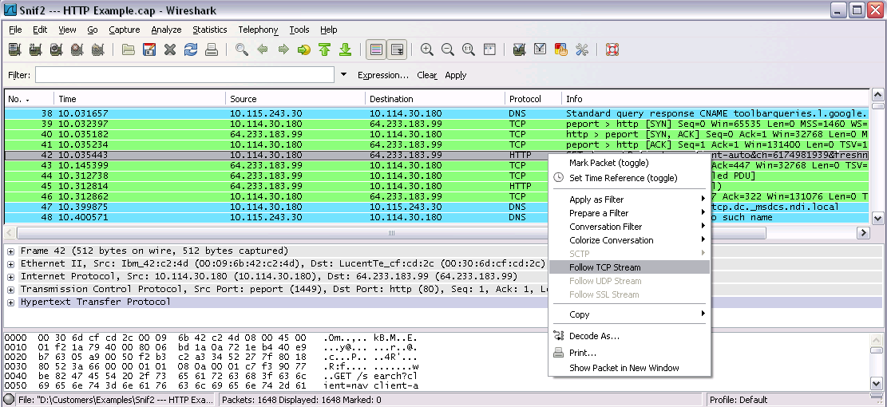
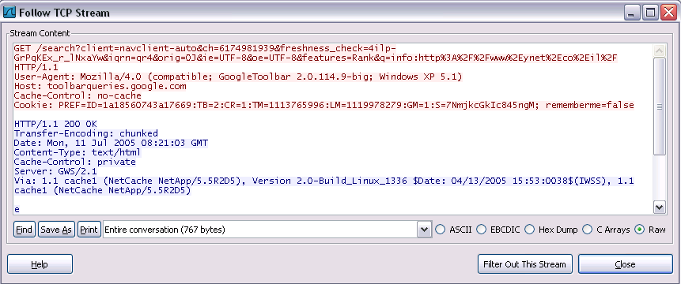
Analyzing Packets (7/9)
Filtering Specific TCP Stream

Slide 15
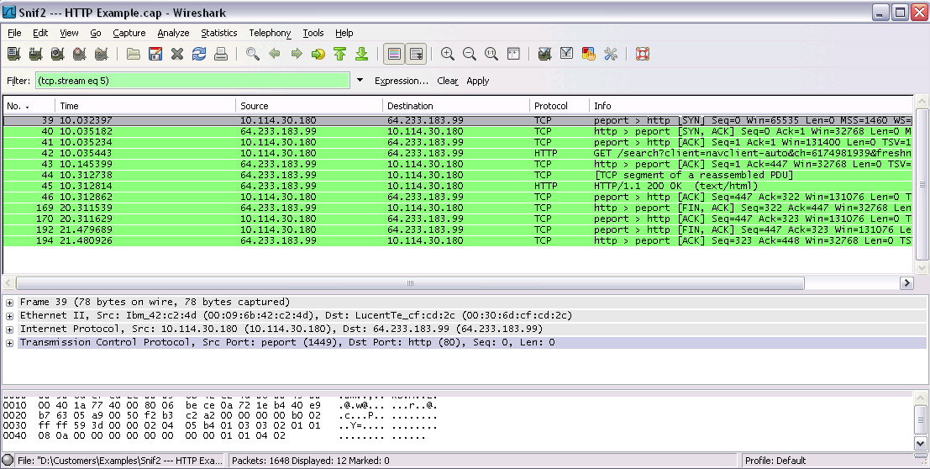
Analyzing Packets (8/9)
Filtering Specific TCP Stream

Slide 16
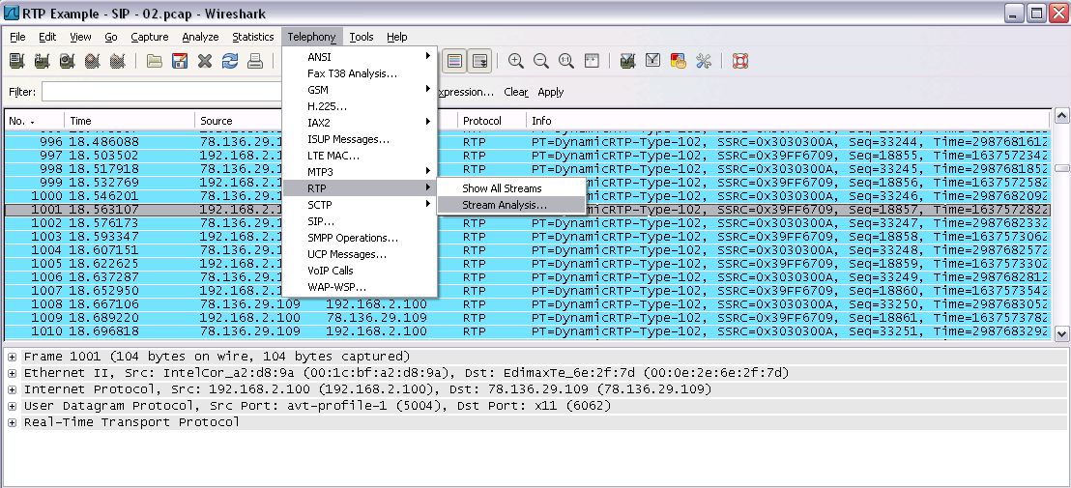
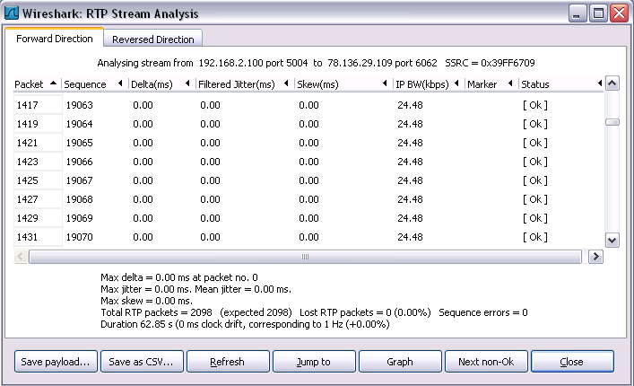
Analyzing Packets (9/9)
RTP Stream Analysis
Stable stream BW

Slide 17
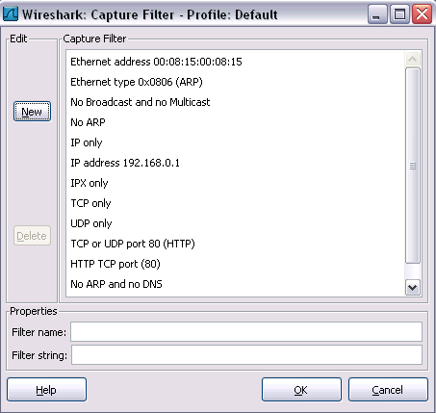
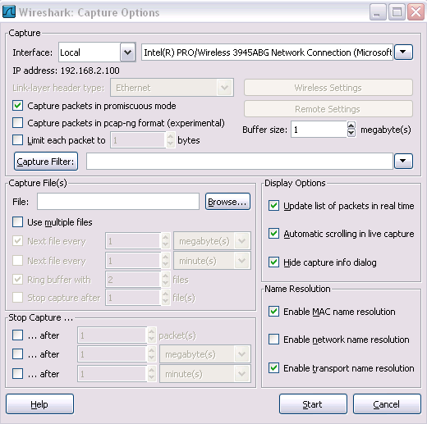
Filtering Packets (1/4)
Applying Filter when Capturing Packets
Capture → Interfaces → Options:

Slide 18
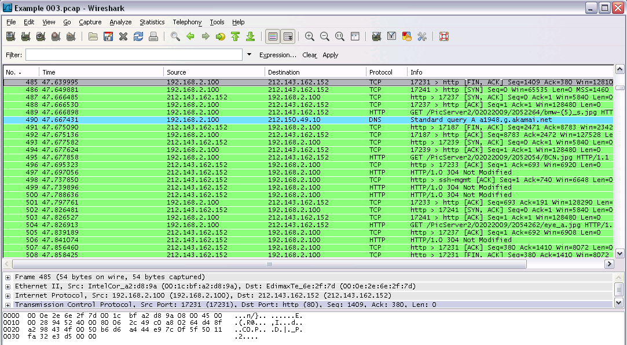
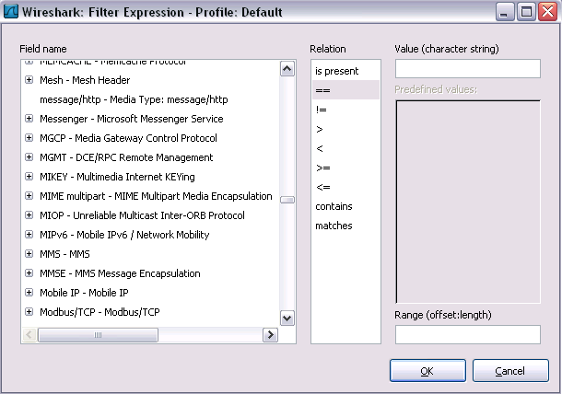
Filtering Packets (2/4)
Applying Filter when Analyzing Packets

Slide 19
Filtering Packets (3/4)
Capture only traffic to or from IP address 172.18.5.4
host 172.18.5.4
Capture traffic to or from a range of IP addresses
net 192.168.0.0/24
net 192.168.0.0 mask 255.255.255.0
Capture traffic from a range of IP addresses
src net 192.168.0.0/24
src net 192.168.0.0 mask 255.255.255.0
Capture traffic to a range of IP addresses
dst net 192.168.0.0/24
dst net 192.168.0.0 mask 255.255.255.0
Capture only DNS (port 53) traffic
port 53
Capture non-HTTP and non-SMTP traffic on your server
host www.example.com and not (port 80 or port 25)
host www.example.com and not port 80 and not port 25
Capture except all ARP and DNS traffic
port not 53 and not arp
Capture traffic within a range of ports
(tcp[2:2] > 1500 and tcp[2:2] < 1550) or (tcp[4:2] > 1500 and tcp[4:2] < 1550)
tcp portrange 1501-1549
Capture only Ethernet type EAPOL
ether proto 0x888e
Capture only IP traffic
(the shortest filter, but sometimes very useful to get rid of lower layer protocols like ARP and STP)
ip
Capture only unicast traffic
(useful to get rid of noise on the network if you only want to see traffic to and from your machine, not, for example, broadcast and multicast announcements)
not broadcast and not multicast

Slide 20
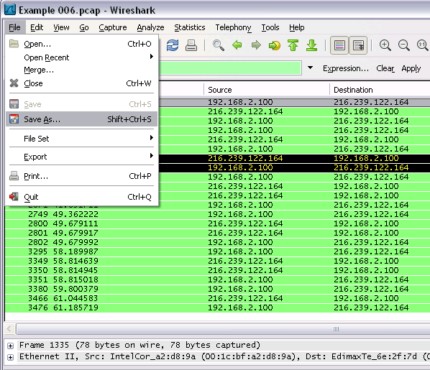
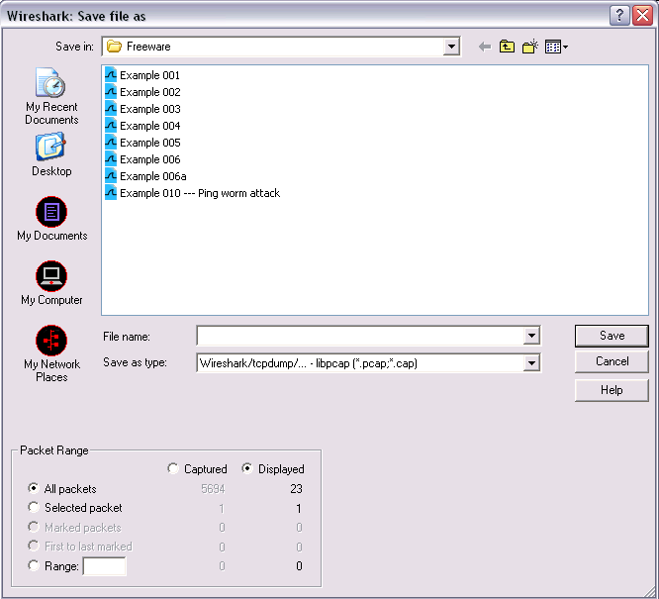
Saving and Manipulating Packets (1/3)
Save only displayed packets

Slide 21
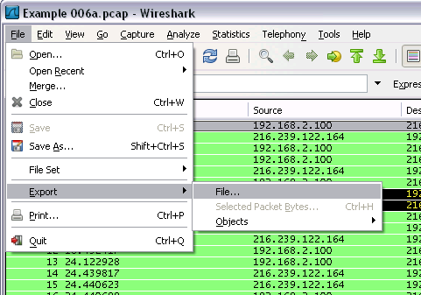
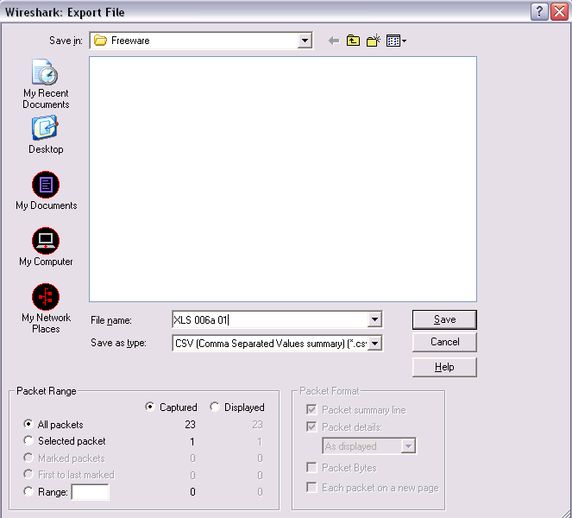
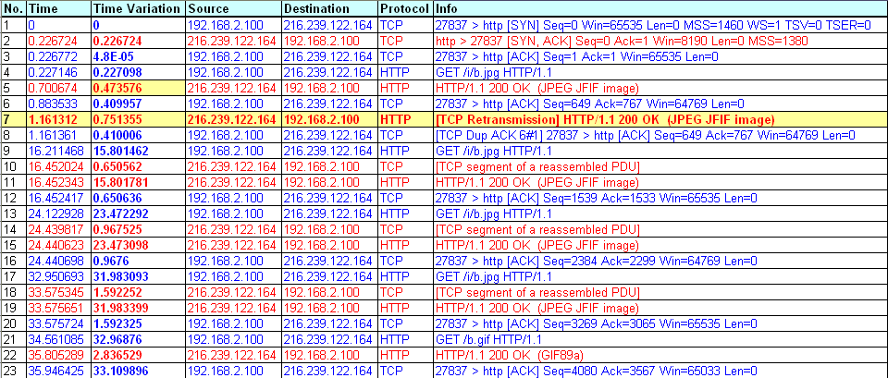
Saving and Manipulating Packets (2/3)
Export to CSV file
Exported CSV File

Slide 22
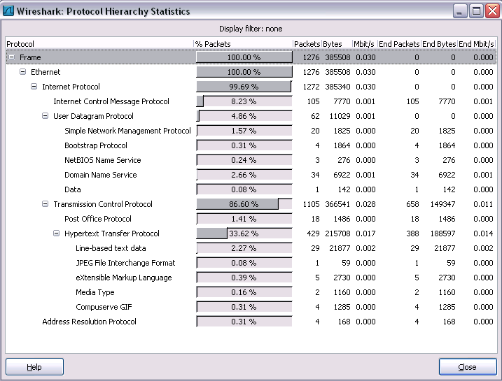
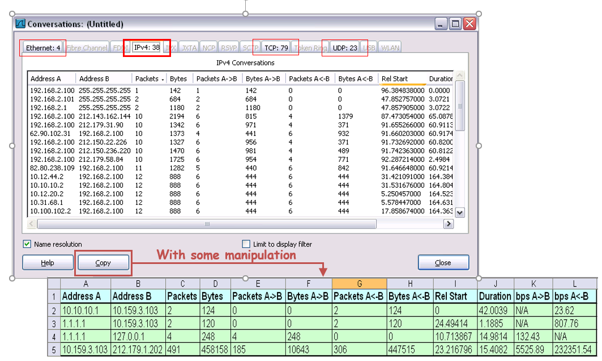
Packet Statistics
Protocol Hierarchy
Conversation
Traffic between two specific endpoints

Slide 23
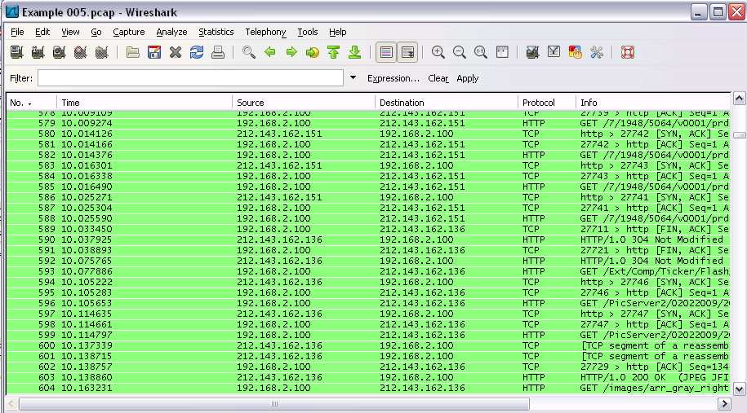
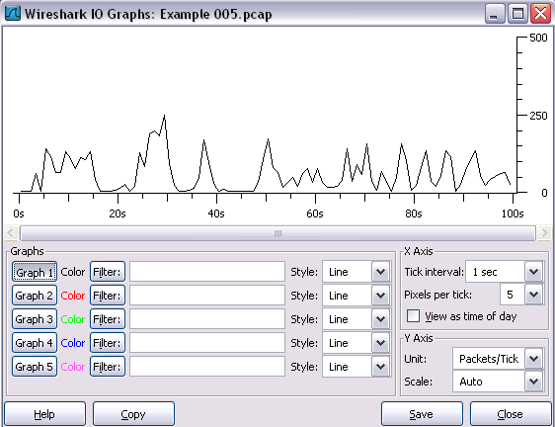
Packet Statistics
I/O Graph
Configurable Options
I/O Graphs
Graph 1-5: enable the specific graph 1-5 (graph 1 by default)
Filter: a display filter for this graph (only the packets that pass this filter will be taken into account for this graph)
Style: the style of the graph (Line/Impulse/FBar/Dot)
X Axis
Tick interval: an interval in x direction lasts (10/1 minutes or 10/1/0.1/0.01/0.001 seconds)
Pixels per tick: use 10/5/2/1 pixels per tick interval
View as time of day: option to view x direction labels as time of day instead of seconds or minutes since beginning of capture
Y Axis
Unit: the unit for the y direction (Packets/Tick, Bytes/Tick, Bits/Tick, Advanced...)
Scale: the scale for the y unit (Logarithmic,Auto,10,20,50,100,200,...)

Slide 24
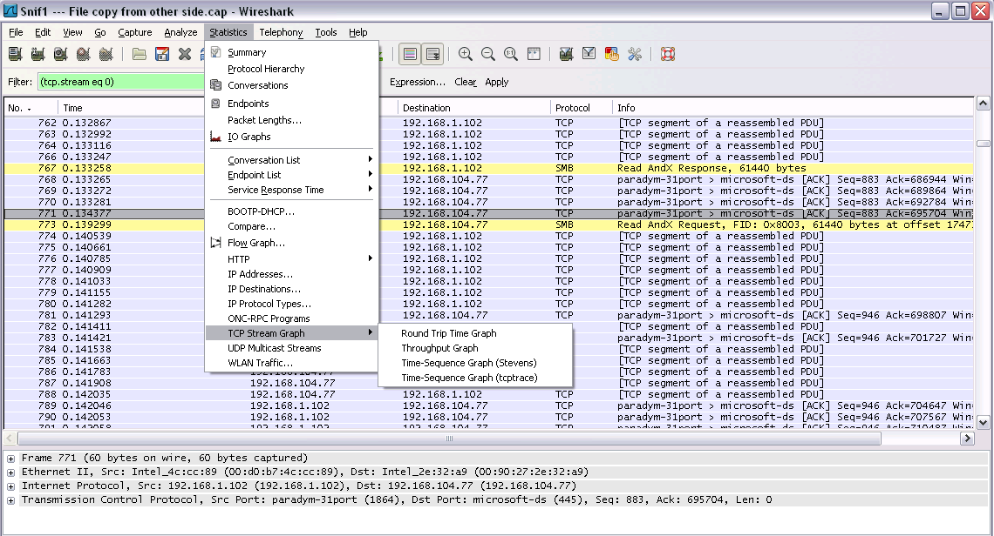
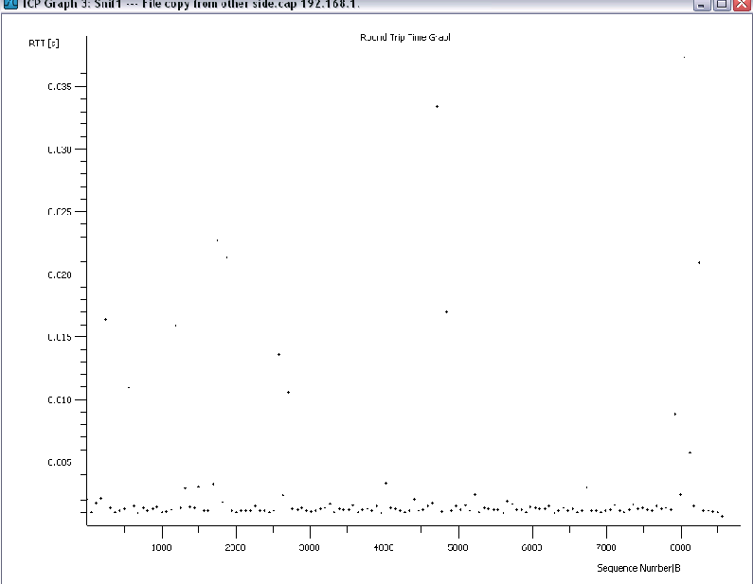



Packet Statistics
TCP Stream Graph
Round-Trip Time Graph
RTT Vs. Sequence numbers gives us the time that take to Ack every packet.
In case of variations, it can cause DUPACKs and even Retransmissions
Usually will happen on communications lines:
Over the Internet
Over cellular networks

Slide 25
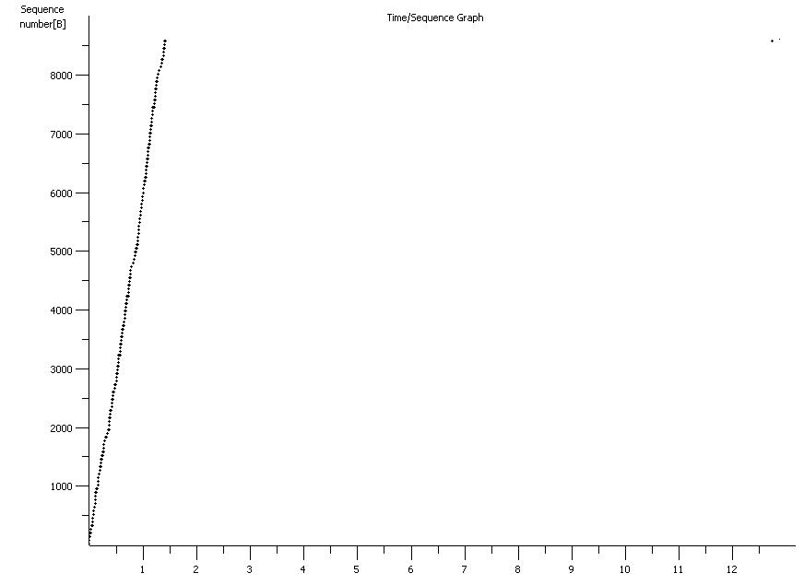
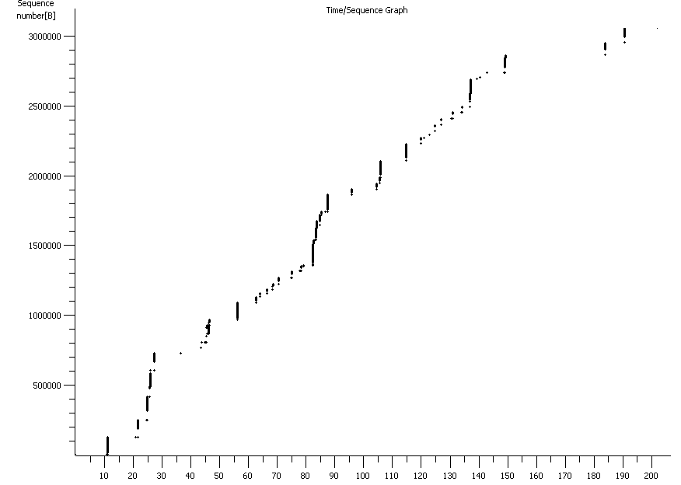
Packet Statistics
Time / Sequence Graph
Time / Sequence Graph
Seq No [B]
Seq No [B]
Time / Sequence represents how sequence numbers advances with time
In a good connection (like in the example), the line will be linear
The angle of the line indicates the speed of the connection. In this example – fast connection
In this case, we see a non-contiguous graph
Can be due to:
Severe packet loss
Server response (processing) time
Time [Sec]
Time [Sec]
Notes:
Time / Sequence representes how sequence numbers advances with time
In a good connection (like in the example), the line will be linear
The angle of the line indicates the speed of the connection. In this example – fast connection

Slide 26
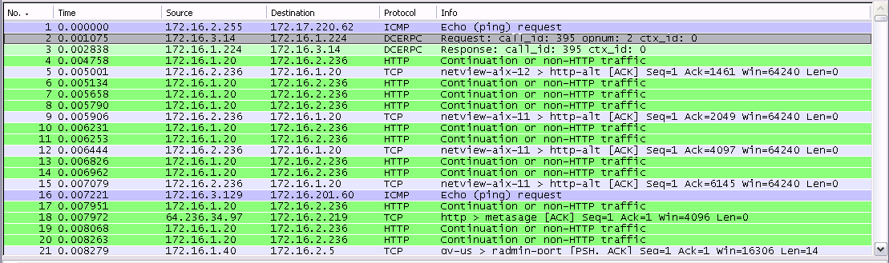
Colorizing Specific Packets (1/4)
Packet Colorization
Colorize packets according to a filter
Allow to emphasize the packets interested in
A lot of Coloring Rule examples at the Wireshark Wiki Coloring Rules page at http://wiki.wireshark.org/ColoringRules
We want to watch a specific protocol through out the capture file

Slide 27
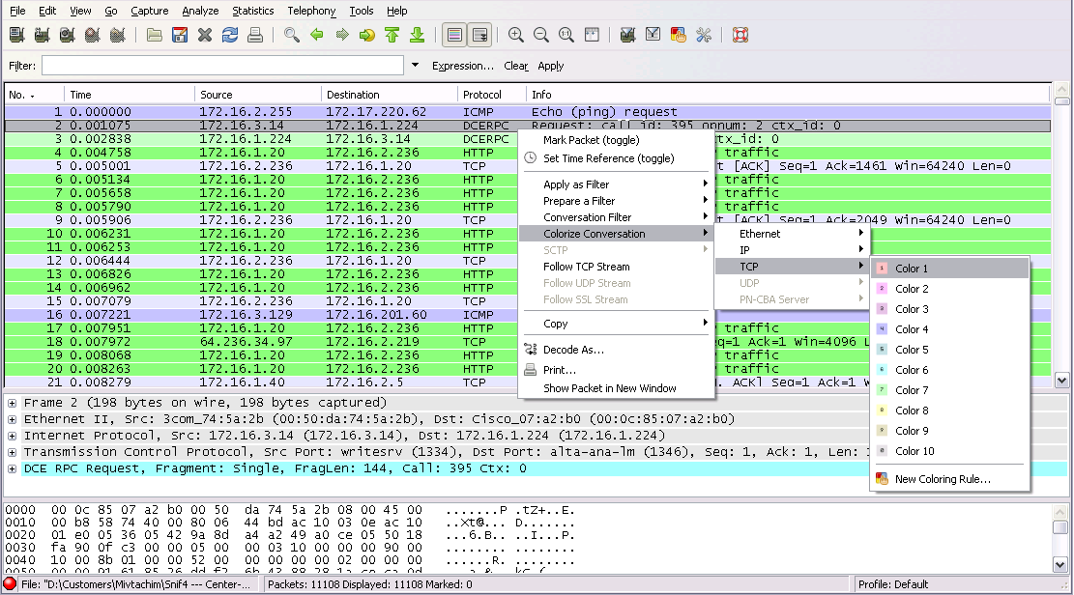
Colorizing Specific Packets (2/4)
Notes:
There are two types of coloring rules in Wireshark. Temporary ones that are only used until you quit the program. And permanent ones that will be saved to a preference file so that they are available on a next session.
Temporary coloring rules can be added by selecting a packet and pressing the <ctrl> key together with one of the number keys. This will create a coloring rule based on the currently selected conversation. It will try to create a conversation filter based on TCP first, then UDP, then IP and at last Ethernet. Temporary filters can also be created by selecting the "Colorize with Filter > Color X" menu items when rightclicking in the packet-detail pane.

Slide 28
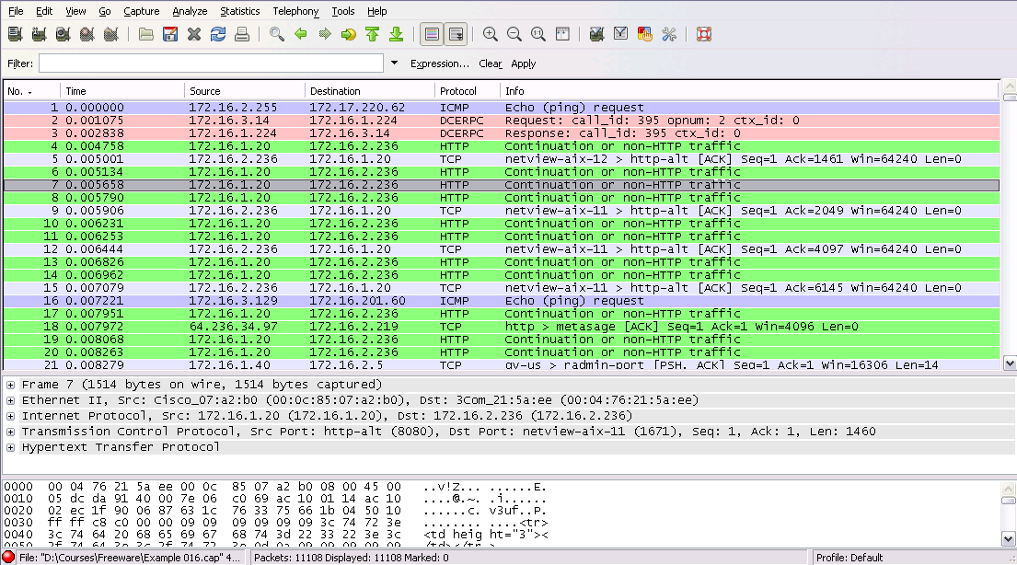
Colorizing Specific Packets (3/4)

Slide 29
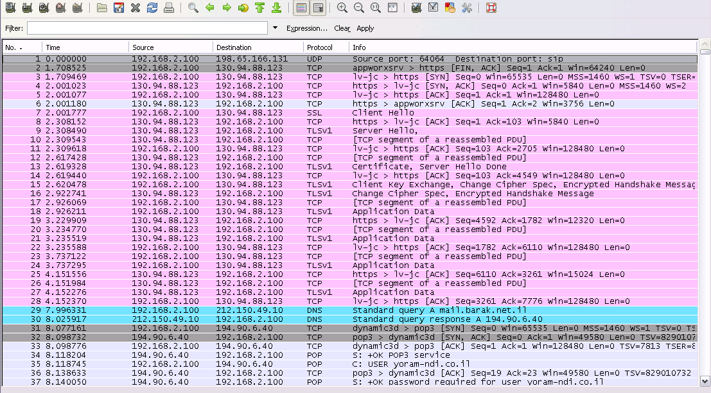
Colorizing Specific Packets (4/4)
TLS Connection Establishment

Slide 30

References
Wireshark Website
http://www.wireshark.org
Wireshark Documentation
http://www.wireshark.org/docs/
Wireshark Wiki
http://wiki.wireshark.org
Network analysis Using Wireshark Cookbook
http://www.amazon.com/Network-Analysis-Using-Wireshark-Cookbook/dp/1849517649

